Slide 1
Implementing Large Language Machines in SEED
Hyun Woo Kim
NREL STM Campus
08/12/2025

Slide 2
Table of Contents
Literature Review
Project goals
Benefits and Applications
Architecture Overview
Challenges
SEED Implementation + Results
Future Work

Slide 3
Literature Review
AI Systems for Database Queries & Quality Control
Achieves >90% accuracy in NL to SQL conversion using context-aware prompting with schema integration [4, 5, 8]
Domain-specific training improves performance by over 20%, while multi-step refinement and chain-of-thought reasoning add ~15% on complex queries
Smart error detection with probabilistic calibration reduces failures by 40% by flagging uncertain queries for human review [1]
Main Takeaway: Context-aware prompting, domain-specific fine-tuning, and uncertainty flagging could possibly be combined to enable SEED’s LLM to reliably translate user questions into database queries while minimizing misinterpretations that require manual correction.
Automated Data Classification Methodologies
Reaches expert-level accuracy with 90% fewer labeled examples by combining LLM knowledge with weak supervision frameworks such as Snorkel [7]
Intelligent prompting with coverage analysis and conflict resolution reduces manual rule-writing effort by ~70%, by generating diverse labeling functions, assessing coverage and conflicts, pruning underperformers, and iterating [2]
Advanced probabilistic aggregation with statistical label models improves accuracy by ~10 points, especially for nuanced, heterogeneous datasets [6]
Main Takeaway: Leveraging LLM-based weak supervision, iterative label refinement, and probabilistic rule aggregation can drastically cut SEED’s labeling effort while improving classification accuracy for complex, heterogeneous building datasets.
Research Gap
Limited application to energy & building data requiring HVAC/equipment expertise
Underexplored LLM deployment in high-security contexts balancing accuracy with strict privacy controls

Slide 4
Project Goals
Enable intelligent querying and tagging of building data via LLM usage
Maintain data security, both within and outside of SEED
Enhance SEED's analytical capability for users without expert guidance

Slide 5





Benefits and Applications
1. Tagging for Dashboards
Auto-tag properties (e.g., pool, solar) using LLMs
Feed into map/table views for better filtering and insights
2. Policy & Funding Detection
Identify buildings eligible for incentives or mandates
Match data to external funding/policy rules
3. Data Quality Audits
Flag missing or inconsistent fields
Improve readiness for compliance or analysis
WHY LLMS?
4. Bulk Custom Reports
Answer complex questions across all buildings
Export structured summaries at scale
5. Natural Language Search
Let users explore data with plain-English queries
Enables insights without needing schema knowledge

Slide 6
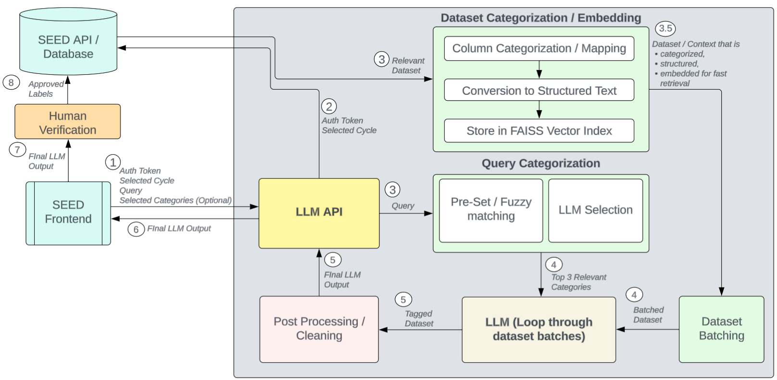




Architecture Overview

Slide 7
Challenges
1. Data Security
Sensitive building data must stay private
Requires strict local processing and secure logging
2. Token Limits
LLMs have input size caps
Long records need batching and filtering to avoid truncation
3. Schema Variability
Inconsistent or missing columns across datasets
Needs flexible mapping and fallback logic
4. Model Reliability and Speed
LLMs may hallucinate or misclassify
Important for high-stakes tasks like compliance or funding

Slide 8
Data Security
1. Local processing pipeline
All embedding, indexing, and querying operations run exclusively on the local machine. As such, no sensitive building data ever leaves the secure environment.
2. Authenticated access with time restrictions
Data retrieval is performed via user authentication tokens sent with each query.
Since tokens automatically expire after predetermined intervals, LLM access to data is naturally time-gated and can only access what the user has access to.
3. Stateless operation with per-query isolation
The LLM is set to have no persistent memory and initializes fresh for each query, preventing data leaks.
Eliminates risk of some other user attempting to gain data they do not have access to via the LLM

Slide 9
Data Security
The Tradeoffs
Local processing pipeline
All embedding, indexing, and querying operations run exclusively on the local machine. As such, no sensitive building data ever leaves the secure environment.
Authenticated access with time restrictions
Data retrieval is performed via user authentication tokens sent with each query.
Since tokens automatically expire after predetermined intervals, LLM access to data is naturally time-gated and can only access what the user has access to.
Stateless operation with per-query isolation
The LLM is set to have no persistent memory and initializes fresh for each query, preventing data leaks.
Eliminates risk of some other user attempting to gain data they do not have access to via the LLM
While this method ensures the data is secure, it’s difficult to gain data to fine tune the LLM, as much of actively used user data are under security constraints. This necessitates either
Non-restricted datasets
Synthetic datasets
Post processed user feedback data to remove sensitive information
Only pre training is available, so no additional context can be added without significant environmental inclusions
Lacks the capability of adaptive LLMS, no real time training and learning

Slide 10
Challenges
1. Data Security
Sensitive building data must stay private
Requires strict local processing and secure logging
2. Token Limits
LLMs have input size caps
Long records need batching and filtering to avoid truncation
3. Schema Variability
Inconsistent or missing columns across datasets
Needs flexible mapping and fallback logic
4. Model Reliability and Speed
LLMs may hallucinate or misclassify
Important for high-stakes tasks like compliance or funding

Slide 11
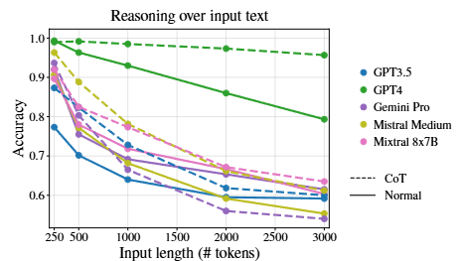
Challenges
1. Data Security
Sensitive building data must stay private
Requires strict local processing and secure logging
2. Token Limits
LLMs have input size caps
Long records need batching and filtering to avoid truncation
3. Schema Variability
Inconsistent or missing columns across datasets
Needs flexible mapping and fallback logic
4. Model Reliability and Speed
LLMs may hallucinate or misclassify
Important for high-stakes tasks like compliance or funding
Longer tokens mean reduced accuracy and longer response times
[9]
Input Token Length vs Accuracy

Slide 12
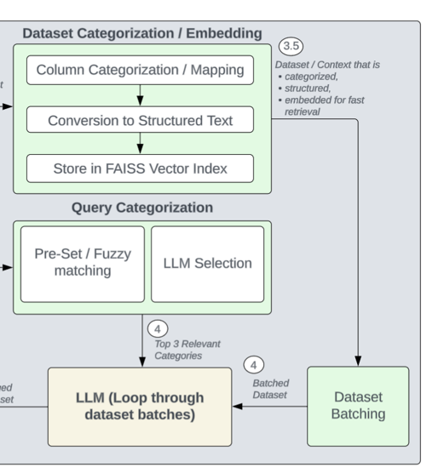
Data Pre-processing
1. Dataset Input → Column Mapping
Raw dataset columns are grouped into standardized semantic categories (e.g., EUI, address)
Fuzzy matching to align inconsistent or misspelled column names to known aliases
2. Row to Text Conversion + Embedding
The dataset is converted into structured text combining mapped fields and additional context
Embeds these text blocks into dense vector representations using a transformer model
3. Batching
Dataset is batched over multiple queries, reducing token size per query

Slide 13
Data Pre-processing
1. Dataset Input → Column Mapping
Raw dataset columns are grouped into standardized semantic categories (e.g., EUI, address)
Fuzzy matching to align inconsistent or misspelled column names to known aliases
2. Row to Text Conversion + Embedding
The dataset is converted into structured text combining mapped fields and additional context
Embeds these text blocks into dense vector representations using a transformer model
3. Batching
Dataset is batched over multiple queries, reducing token size per query
Only relevant categories are sent to the LLM during query, reducing token count

Slide 14
Data Pre-processing
1. Dataset Input → Column Mapping
Raw dataset columns are grouped into standardized semantic categories (e.g., EUI, address)
Fuzzy matching to align inconsistent or misspelled column names to known aliases
2. Row to Text Conversion + Embedding
The dataset is converted into structured text combining mapped fields and additional context
Embeds these text blocks into dense vector representations using a transformer model
3. Batching
Dataset is batched over multiple queries, reducing token size per query
Instead of sending everything in one query, data is embedded so the LLM only retrieves relevant context as needed.

Slide 15
Data Pre-processing
1. Dataset Input → Column Mapping
Raw dataset columns are grouped into standardized semantic categories (e.g., EUI, address)
Fuzzy matching to align inconsistent or misspelled column names to known aliases
2. Row to Text Conversion + Embedding
The dataset is converted into structured text combining mapped fields and additional context
Embeds these text blocks into dense vector representations using a transformer model
3. Batching
Dataset is batched over multiple queries, reducing token size per query
The dataset is batched into numerous queries to reduce token size

Slide 16
Challenges
1. Data Security
Sensitive building data must stay private
Requires strict local processing and secure logging
2. Token Limits
LLMs have input size caps
Long records need batching and filtering to avoid truncation
3. Schema Variability
Inconsistent or missing columns across datasets
Needs flexible mapping and fallback logic
4. Model Reliability and Speed
LLMs may hallucinate or misclassify
Important for high-stakes tasks like compliance or funding

Slide 17
Challenges
1. Data Security
Sensitive building data must stay private
Requires strict local processing and secure logging
2. Token Limits
LLMs have input size caps
Long records need batching and filtering to avoid truncation
3. Schema Variability
Inconsistent or missing columns across datasets
Needs flexible mapping and fallback logic
4. Model Reliability and Speed
LLMs may hallucinate or misclassify
Important for high-stakes tasks like compliance or funding
Added a user verification step before data label can be added
Batching also helps with model reliability and speed by reducing token count

Slide 18
Architecture Overview
Llama 8B LLM
(Loops through batches)

Slide 19
Challenges
Other Practical Limitations / Challenges
Computational
The primary effort was something that could be reasonably deployable with minimal cost
This effort was focused mostly on the performance given one Nvidia 4090 GPU.
Data / Time Restrictions
Some initial forays into QLoRa based fine tuning were performed
Time and data restrictions made fine-tuned model development and testing difficult, so a focus was put on base / zero-shot models and performance for the scope of this project
1. Data Security
Sensitive building data must stay private
Requires strict local processing and secure logging
2. Token Limits
LLMs have input size caps
Long records need batching and filtering to avoid truncation
3. Schema Variability
Inconsistent or missing columns across datasets
Needs flexible mapping and fallback logic
4. Model Reliability and Speed
LLMs may hallucinate or misclassify
Important for high-stakes tasks like compliance or funding
Embedding and inference can be slow
Needs efficient pipelines and UI integration for real use

Slide 20
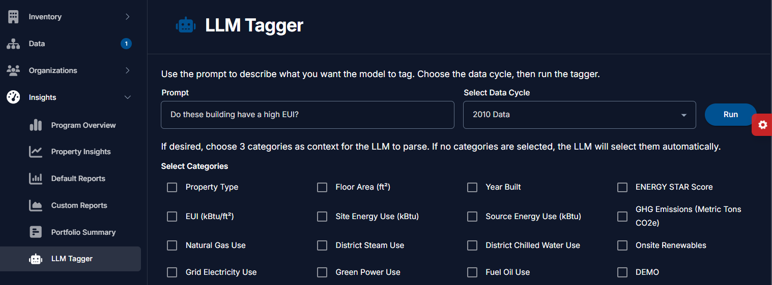
SEED Implementation
Dataset Selection
Category Selection
Query Input

Slide 21
SEED Implementation
Dataset Selection
Category Selection
Query Input

Slide 22
SEED Implementation
Dataset Selection
Category Selection
Query Input

Slide 23
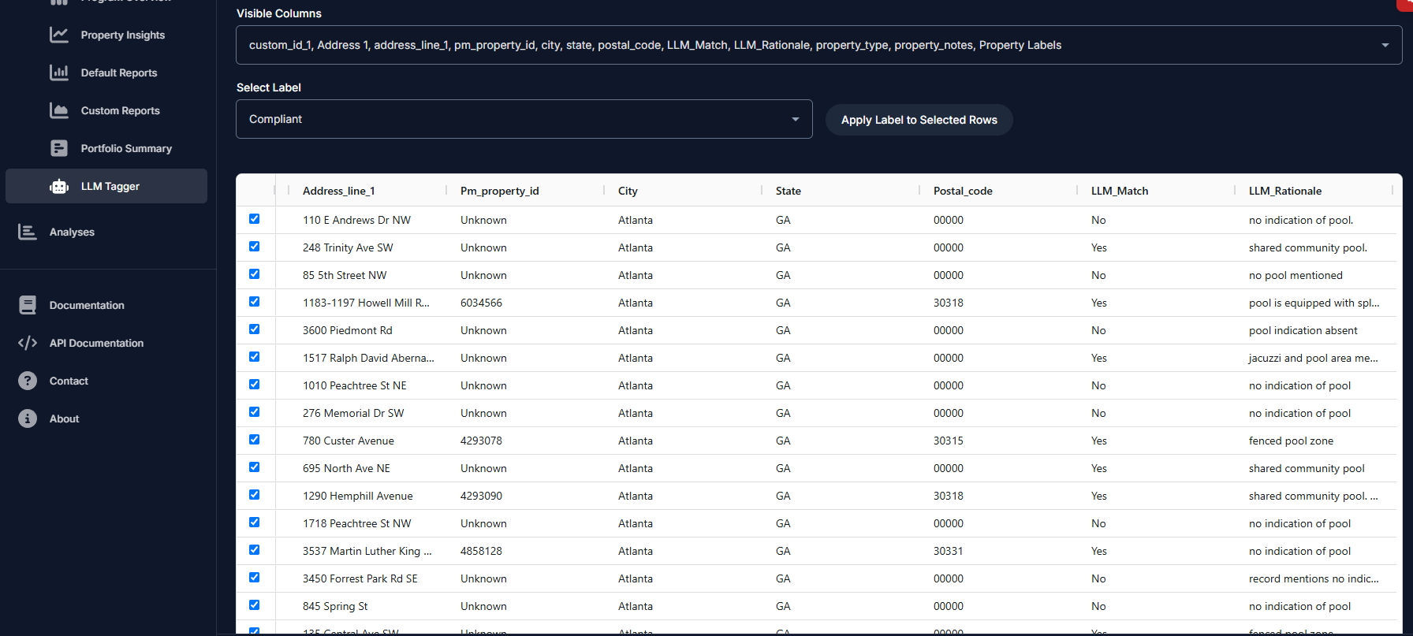
SEED Implementation
LLM Results
Results Preview
Human Verification
Labeling Input

Slide 24
SEED Implementation
Apply Label
Results Preview
Human Verification
Labeling Input

Slide 25
Results
Performance
Decent accuracy on dense / more verbose synthetic datasets (70%+ accuracy)
Example: Does this building have a pool?
Decent performance with multi category datasets (70%+ accuracy)
Example: Does this building have a commercial pool?
Struggled with information overflow
(i.e Source / Site / Adjusted / Median / Normalized … EUI)
More domain knowledge or routing to a second-stage smaller more specifically trained model may be possible for high demand queries
Struggled with additional context-based searches
(i.e providing policy data in a retrieval augmented generation (RAG) format and asking the LLM “tag which building are applicable for X policy funding”

Slide 26
Results
Performance
Decent accuracy on dense / more verbose synthetic datasets (70%+ accuracy)
Decent performance with multi category datasets (70%+ accuracy)
Example: Does this building have a commercial pool?
Struggled with information overflow
(i.e Source / Site / Adjusted / Median / Normalized … EUI)
More domain knowledge or routing to a second-stage smaller more specifically trained model may be possible for high demand queries
Struggled with additional context-based searches
(i.e providing policy data in a retrieval augmented generations (RAG) format and asking the LLM “tag which building are applicable for X policy funding”
Additional Caveats
Testing limited to synthetic datasets that may have “obvious” or leading answers
Current results are terse for increased response speed, with general support leading towards “Yes/No” type questions. \
Increased detail means lower accuracy and increased response times
Response times average 15+ seconds
5 seconds for dataset preprocessing
100 buildings takes about 7-9 seconds, and scales linearly. (1000 buildings takes slightly over a minute)

Slide 27
Future Work
Fine-Tuning LLMs:
Apply QLoRA or similar methods for domain-specific optimization.
Tailor model performance for energy/building datasets.
Integrating Domain Knowledge:
Incorporate additional domain knowledge (i.e ASHRAE Handbook guidelines for HVAC systems)
Embed EUI benchmarks for building performance context.
Expanded Feature Integration:
Link LLM outputs to interactive visualizations (e.g., energy dashboards, geospatial maps).
Enable policy analysis workflows (e.g., local code compliance checks, incentive programs).
Advanced Querying & Analytics:
Multi-modal capabilities (combine text, tabular, and geospatial inputs).
Natural language to multi-stage labeling pipelines.
User-Centric Enhancements:
Explainable AI outputs for transparency.
Feedback-driven refinement and continual learning.

Slide 28
Citations
Chen, K., Y. Chen, X. Yu, and N. Koudas. "Reliable Text-to-SQL with Adaptive Abstention." arXiv, January 2025. https://arxiv.org/abs/2501.10858.
Guan, N., et al. "Cost-Efficient Label Function Design via Prompting Large Language Models (DataSculpt)." In Proceedings of the 28th International Conference on Extending Database Technology (EDBT 2025). 2025. https://www.openproceedings.org/2025/conf/edbt/paper-73.pdf.
Hong, Z., Z. Yuan, Q. Zhang, H. Chen, J. Dong, F. Huang, and X. Huang. "Next-Generation Database Interfaces: A Survey of LLM-based Text-to-SQL." arXiv, June 2024. https://arxiv.org/abs/2406.08426.
Huang, X., Q. Li, L. Cui, and Y. Liu. "Large Language Model Enhanced Text-to-SQL Generation: A Survey." arXiv, October 2024. https://arxiv.org/abs/2410.06011.
Huang, Y. M., J. Guo, W. Mao, C. Gao, P. Han, C. Liu, and Q. Ling. "Exploring the Landscape of Text-to-SQL with Large Language Models: Progresses, Challenges and Opportunities." arXiv, May 2025. https://arxiv.org/abs/2505.23838.
Leite, J.A., O. Razuvayevskaya, K. Bontcheva, et al. "Weakly supervised veracity classification with LLM-predicted credibility signals." EPJ Data Science 14, no. 16 (2025). https://doi.org/10.1140/epjds/s13688-025-00534-0.
Li, C., D. Zhang, and J. Wang. "LLM-Assisted Labeling Function Generation for Semantic Type Detection." arXiv, August 2024. https://arxiv.org/html/2408.16173v1.
Singh, A., A. Shetty, A. Ehtesham, S. Kumar, and T. Talaei Khoei. "A Survey of Large Language Model-Based Generative AI for Text-to-SQL: Benchmarks, Applications, Use Cases, and Challenges." arXiv, December 2024. https://arxiv.org/abs/2412.05208.
Levy, Mosh, Alon Jacoby, and Yoav Goldberg. "Same Task, More Tokens: the Impact of Input Length on the Reasoning Performance of Large Language Models." arXiv preprint arXiv:2402.14848 (2024). https://arxiv.org/abs/2402.14848.

Slide 29
Thank you!

